Slide 1

Chapter 24
Congestion Control and
Quality of Service
Copyright © The McGraw-Hill Companies, Inc. Permission required for reproduction or display.

Slide 2
24-1 DATA TRAFFIC
The main focus of congestion control and quality of service is data traffic. In congestion control we try to avoid traffic congestion. In quality of service, we try to create an appropriate environment for the traffic. So, before talking about congestion control and quality of service, we discuss the data traffic itself.
Topics discussed in this section:
Traffic Descriptor Traffic Profiles

Slide 3
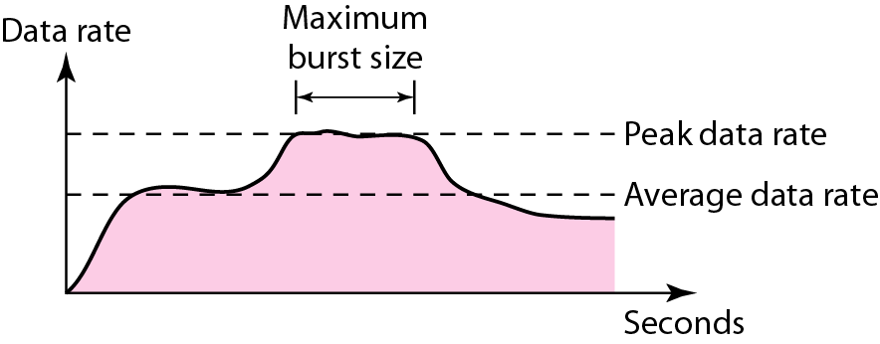
Figure 24.1 Traffic descriptors

Slide 4
Average date rate
The average data rate is the number of bits sent during a period of time, divided by the number of seconds in that period.
Average data rate= amount of data/time

Slide 5
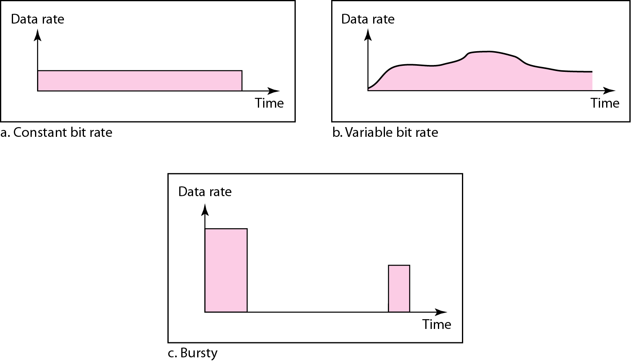
Figure 24.2 Three traffic profiles

Slide 6
24-2 CONGESTION
Congestion in a network may occur if the load on the network—the number of packets sent to the network—is greater than the capacity of the network—the number of packets a network can handle. Congestion control refers to the mechanisms and techniques to control the congestion and keep the load below the capacity.
Topics discussed in this section:
Network Performance

Slide 7
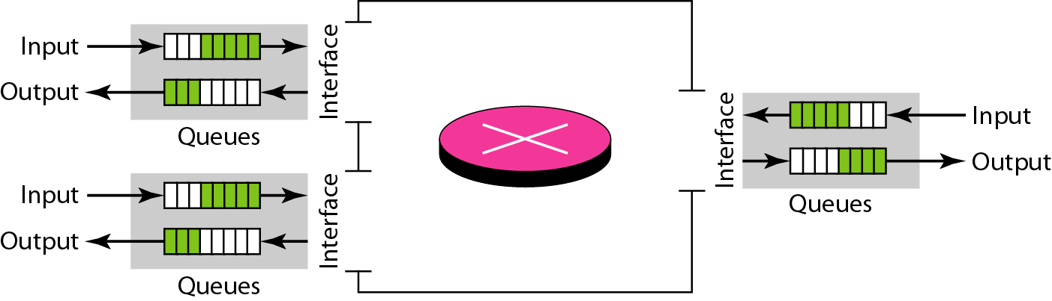
Figure 24.3 Queues in a router

Slide 8
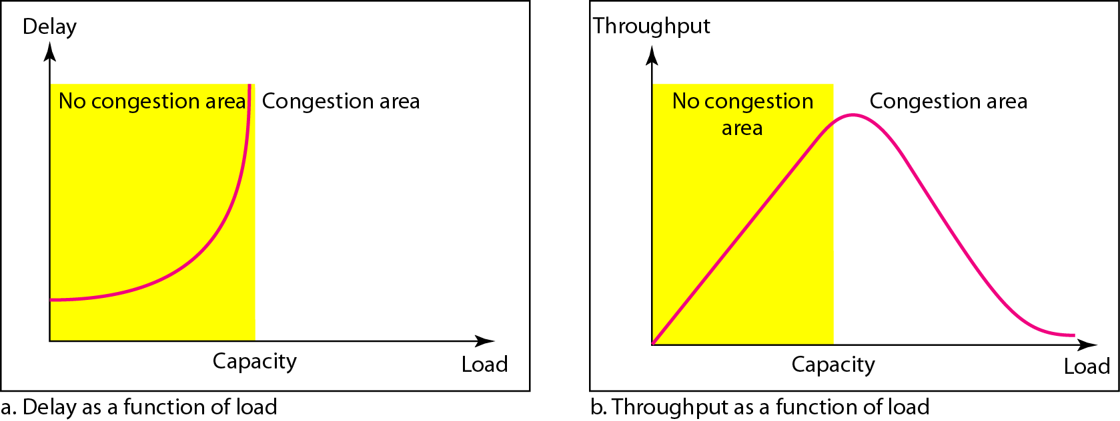
Network Performance
Figure Packet delay and throughput as functions of load

Slide 9
24-3 CONGESTION CONTROL
Congestion control refers to techniques and mechanisms that can either prevent congestion, before it happens, or remove congestion, after it has happened. In general, we can divide congestion control mechanisms into two broad categories: open-loop congestion control (prevention) and closed-loop congestion control (removal).
Topics discussed in this section:
Open-Loop Congestion Control Closed-Loop Congestion Control

Slide 10
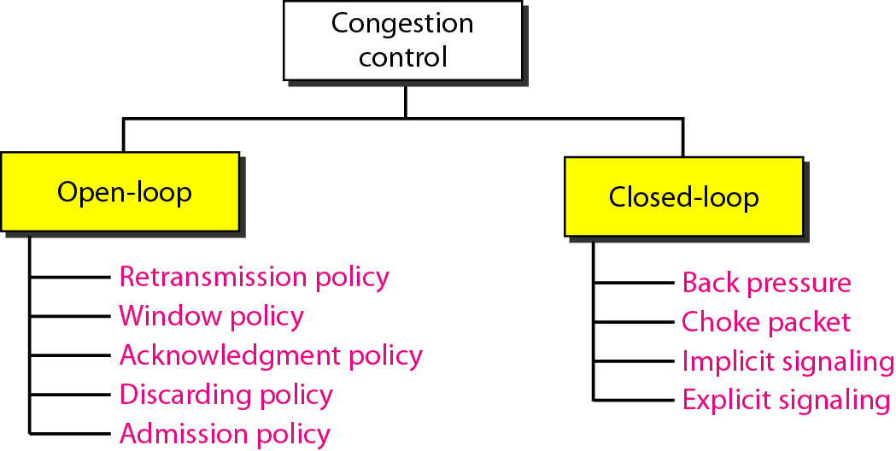
Figure 24.5 Congestion control categories

Slide 11
Open Loop Congestion Control
Open loop congestion control policies are applied to prevent congestion before it happens. The congestion control is handled either by the source or the destination.
Retransmission Policy : It is the policy in which retransmission of the packets are taken care of. If the sender feels that a sent packet is lost or corrupted, the packet needs to be retransmitted. This transmission may increase the congestion in the network. To prevent congestion, retransmission timers must be designed to prevent congestion and also able to optimize efficiency.
Window Policy : The type of window at the sender’s side may also affect the congestion. Several packets in the Go-back-n window are re-sent, although some packets may be received successfully at the receiver side. This duplication may increase the congestion in the network and make it worse. Therefore, Selective repeat window should be adopted as it sends the specific packet that may have been lost.

Slide 12
Discarding Policy : A good discarding policy adopted by the routers is that the routers may prevent congestion and at the same time partially discard the corrupted or less sensitive packages and also be able to maintain the quality of a message.
Acknowledgment Policy : Since acknowledgements are also the part of the load in the network, the acknowledgment policy imposed by the receiver may also affect congestion. Several approaches can be used to prevent congestion related to acknowledgment. The receiver should send acknowledgement for N packets rather than sending acknowledgement for a single packet. The receiver should send an acknowledgment only if it has to send a packet or a timer expires.

Slide 13
Admission Policy : In admission policy a mechanism should be used to prevent congestion. Switches in a flow should first check the resource requirement of a network flow before transmitting it further. If there is a chance of a congestion or there is a congestion in the network, router should deny establishing a virtual network connection to prevent further congestion.

Slide 14
Closed Loop Congestion Control
Closed loop congestion control techniques are used to treat or alleviate congestion after it happens. Several techniques are used by different protocols; some of them are:
Backpressure : Backpressure is a technique in which a congested node stops receiving packets from upstream node. This may cause the upstream node or nodes to become congested and reject receiving data from above nodes. Backpressure is a node-to-node congestion control technique that propagate in the opposite direction of data flow. The backpressure technique can be applied only to virtual circuit where each node has information of its above upstream node.

Slide 15
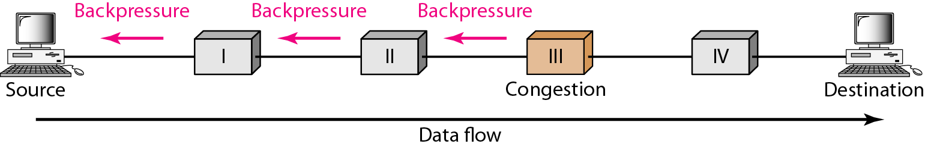
Figure 24.6 Backpressure method for alleviating congestion
In above diagram the 3rd node is congested and stops receiving packets as a result 2nd node may be get congested due to slowing down of the output data flow. Similarly 1st node may get congested and inform the source to slow down.

Slide 16
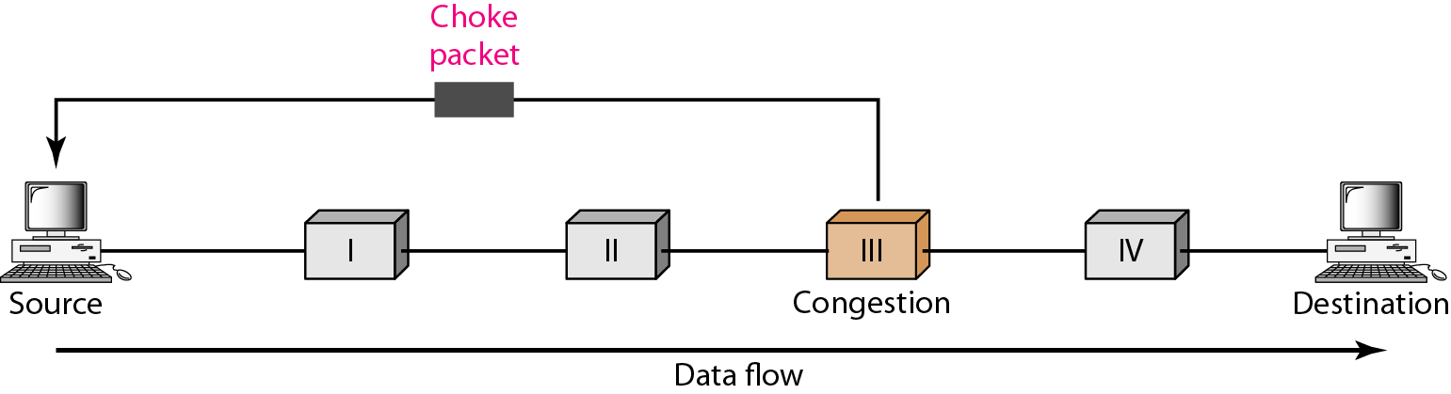
Figure 24.7 Choke packet

Slide 17
Choke Packet Technique : Choke packet technique is applicable to both virtual networks as well as datagram subnets. A choke packet is a packet sent by a node to the source to inform it of congestion. Each router monitors its resources and the utilization at each of its output lines. Whenever the resource utilization exceeds the threshold value which is set by the administrator, the router directly sends a choke packet to the source giving it a feedback to reduce the traffic. The intermediate nodes through which the packets has traveled are not warned about congestion.

Slide 18
Implicit Signaling : In implicit signaling, there is no communication between the congested nodes and the source. The source guesses that there is congestion in a network. For example when sender sends several packets and there is no acknowledgment for a while, one assumption is that there is a congestion.

Slide 19
Explicit Signaling :In explicit signaling, if a node experiences congestion it can explicitly sends a packet to the source or destination to inform about congestion. The difference between choke packet and explicit signaling is that the signal is included in the packets that carry data rather than creating a different packet as in case of choke packet technique. Explicit signaling can occur in either forward or backward direction.

Slide 20
Forward Signaling : In forward signaling, a signal is sent in the direction of the congestion. The destination is warned about congestion. The receiver in this case adopt policies to prevent further congestion.
Backward Signaling : In backward signaling, a signal is sent in the opposite direction of the congestion. The source is warned about congestion and it needs to slow down.

Slide 21
24-4 TWO EXAMPLES
To better understand the concept of congestion control, let us give two examples: one in TCP and the other in Frame Relay.
Topics discussed in this section:
Congestion Control in TCP Congestion Control in Frame Relay

Slide 22
Congestion Control Mechanisms
Additive Increase/Multiplicative Decrease
Slow start
Fast retransmit & Fast recovery

Slide 23
Congestion control in TCP
Actual window size =min (rwnd, cwnd)
Congestion Window (cwnd) is a TCP state variable that limits the amount of data the TCP can send into the network before receiving an ACK.
The Receiver Window (rwnd) is a variable that advertises the amount of data that the destination side can receive.

Slide 24
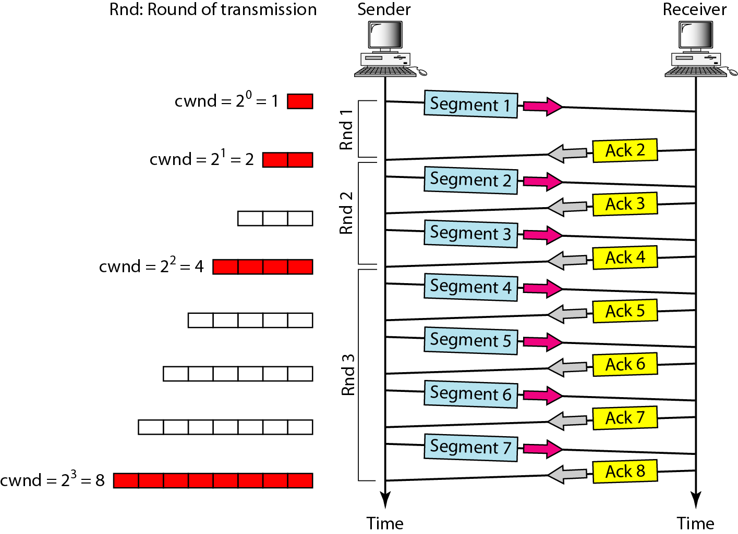
Figure 24.8 Slow start, exponential increase

Slide 25

Note
In the slow-start algorithm, the size of the congestion window increases exponentially until it reaches a threshold.

Slide 26
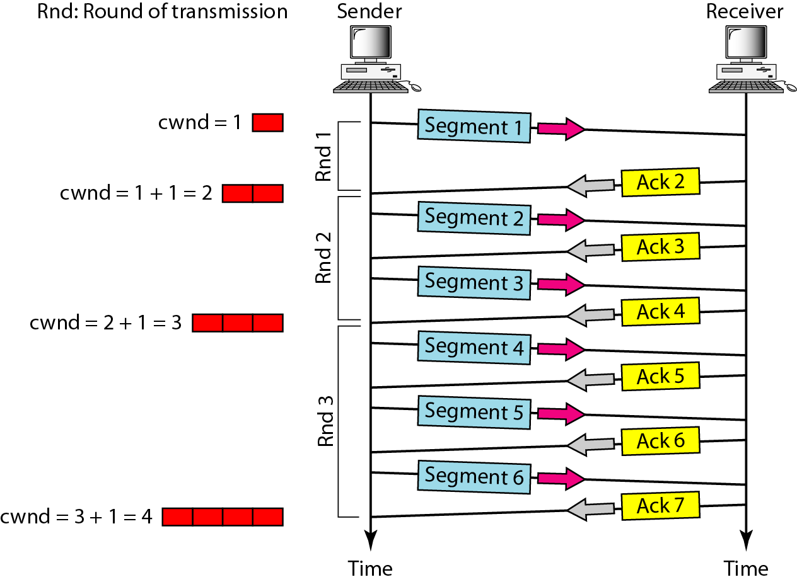
Figure 24.9 Congestion avoidance, additive increase

Slide 27
Note
In the congestion avoidance algorithm, the size of the congestion window increases additively until congestion is detected.

Slide 28
Note
An implementation reacts to congestion detection in one of the following ways:
❏ If detection is by time-out, a new slow start phase starts.
❏ If detection is by three ACKs, a new congestion avoidance phase starts.

Slide 29
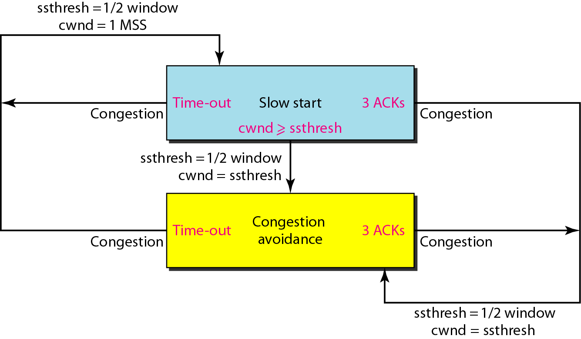
Figure 24.10 TCP congestion policy summary
Max segment size

Slide 30
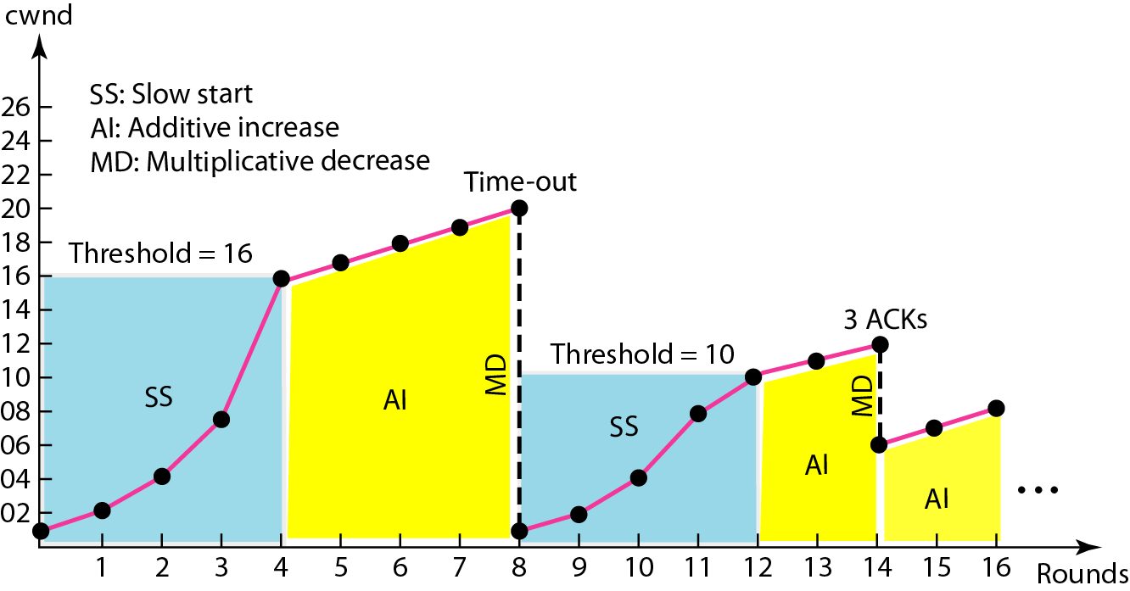
Figure 24.11 Congestion example

Slide 31
Congestion in Frame Relay decreases throughput and increases delay.
A high throughput and low delay is the main goal of Frame Relay protocol.
Frame Relay does not have flow control and it allows user to transmit burst data.
This means that a Frame Relay network has potential to be really congested with traffic, requiring congestion control.
Frame Relay uses congestion avoidance by means of two bit fields present in the Frame Relay frame to explicitly warn source and destination of presence of congestion:

Slide 32
BECN:
Backward Explicit Congestion Notification (BECN) warns the sender of congestion present in the network. This is achieved by resending the frame in reverse direction with the help of switches in the network. This warning can be responded by the sender by reducing the transmission data rate, thus reducing congestion effects in the network.
FECN:
Forward Explicit Congestion Notification (FECN) is used to warn the receiver of congestion in the network. It might appear that receiver cannot do anything to relieve the congestion, however the Frame Relay protocol assumes that sender and receiver are communicating with each other and when it receives FECN bit as 1 receiver delays the acknowledgement. This forces sender to slow down and reducing effects of congestion in the network.

Slide 33
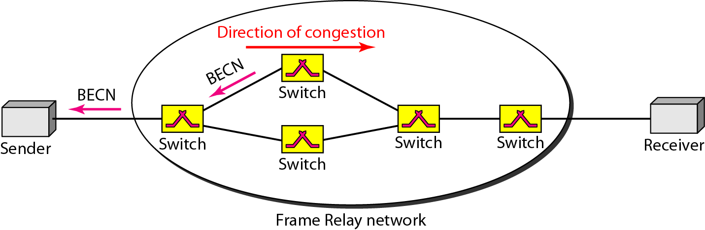
Figure 24.12 BECN

Slide 34
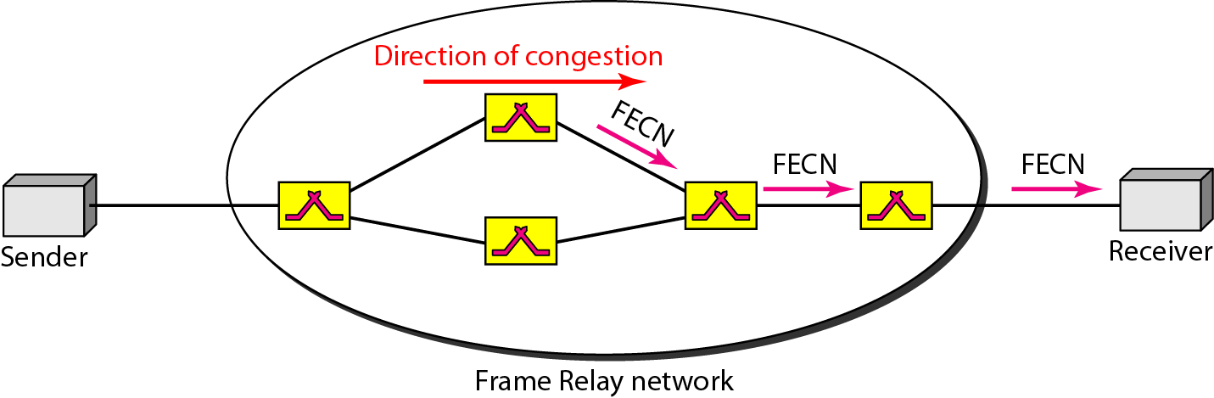
Figure 24.13 FECN

Slide 35
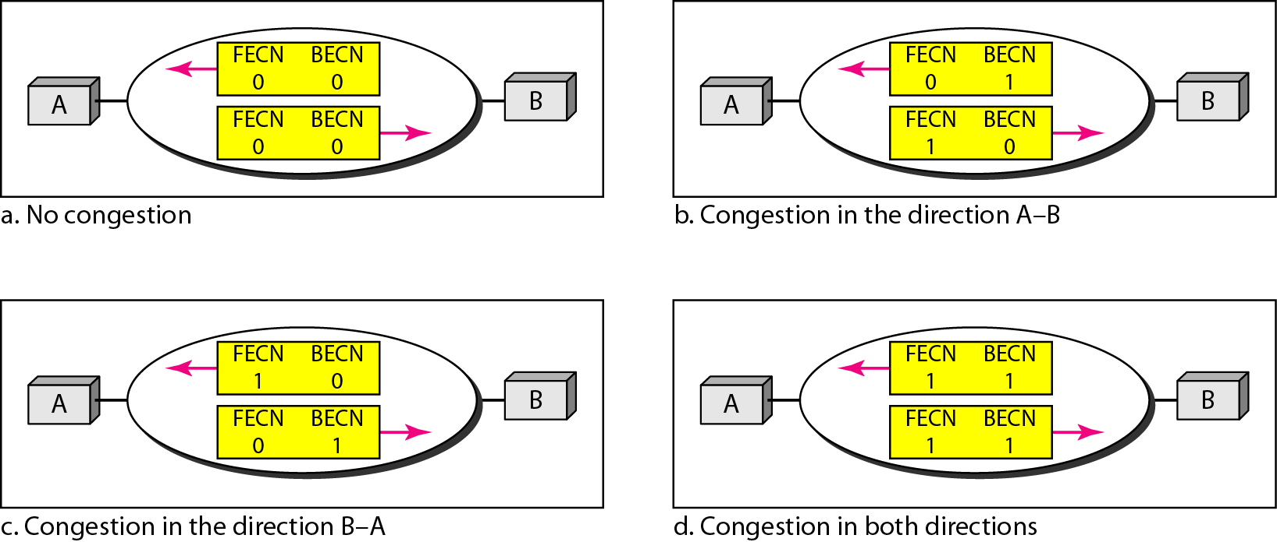
Figure 24.14 Four cases of congestion

Slide 36
24-5 QUALITY OF SERVICE
Quality of service (QoS) is an internetworking issue that has been discussed more than defined. We can informally define quality of service as something a flow seeks to attain.
Topics discussed in this section:
Flow Characteristics Flow Classes

Slide 37
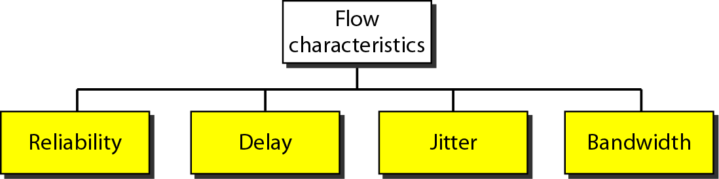
Figure 24.15 Flow characteristics

Slide 38
QOS Parameters
Reliability
Lack of reliability means losing a packet or acknowledgment(being sent on its successful reach to destination), which entails retransmission.
However, the sensitivity of any application programs to reliability is not the same. for e.g file transfer and email service require reliable service unlike telephone or audio conferencing.
Transit Delay
It is the time between a message being sent by the transport user on the source machine and its being received by the transport user in the destination machine.

Slide 39
Jitter is the variation in delay for packets associated with the same flow. For applications such as audio and video applications, it does not matter if the packets arrive with a short or long delay as long as the delay is the same for all packets.
High jitter means the difference between delays(of packets of data) is large, low jitter means the variation is small.
bandwidth : The effective bandwidth is the bandwidth that the network needs to allocate for the flow of traffic. The effective bandwidth is basically a function of three values i.e average data rate, peak data rate, and maximum burst size.

Slide 40
24-6 TECHNIQUES TO IMPROVE QoS
In Section 24.5 we tried to define QoS in terms of its characteristics. In this section, we discuss some techniques that can be used to improve the quality of service. We briefly discuss four common methods: scheduling, traffic shaping, admission control, and resource reservation.
Topics discussed in this section:
Scheduling Traffic Shaping Resource Reservation
Admission Control

Slide 41
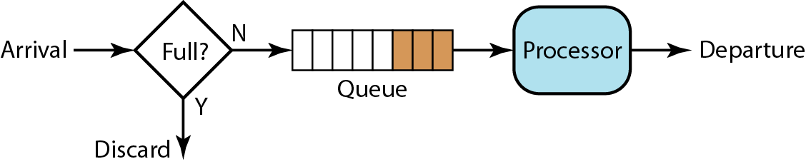
Scheduling
Figure 24.16 FIFO queue

Slide 42
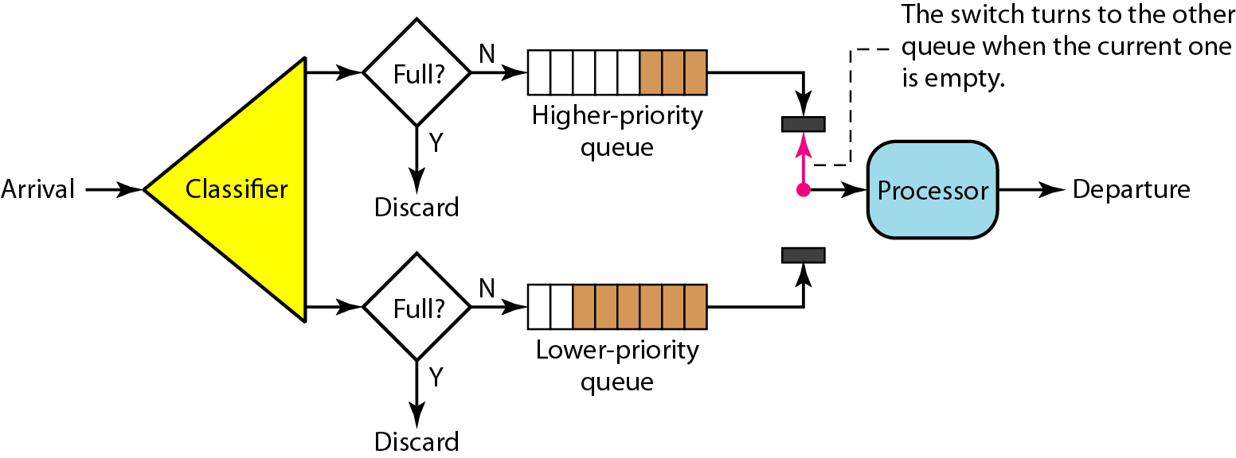
Figure 24.17 Priority queuing

Slide 43
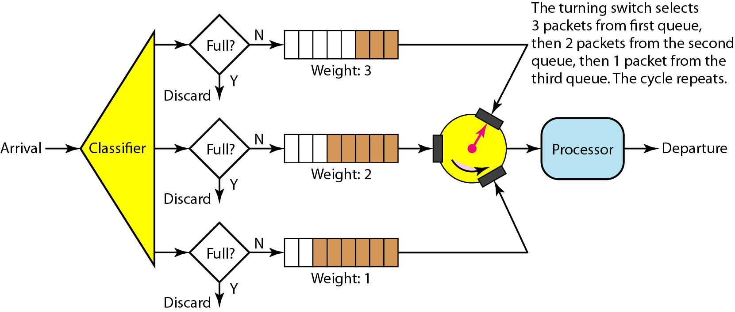
Figure 24.18 Weighted fair queuing

Slide 44
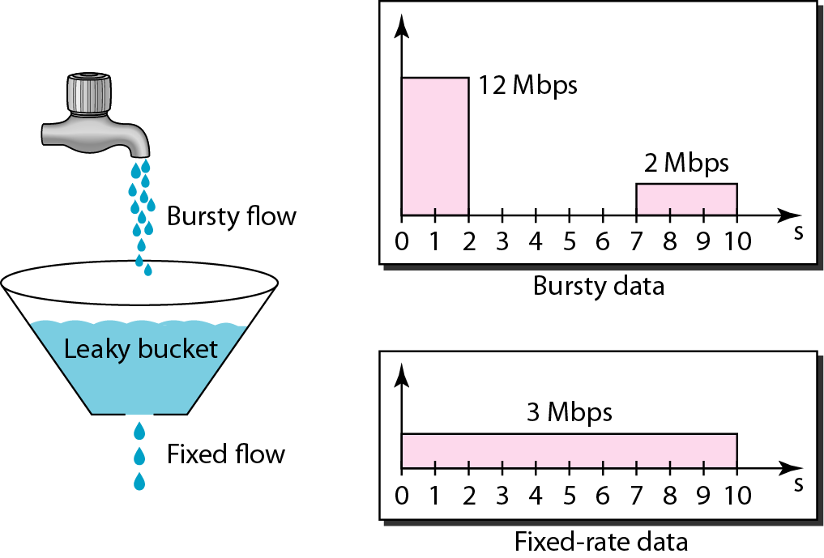
Traffic shaping
Figure 24.19 Leaky bucket

Slide 45
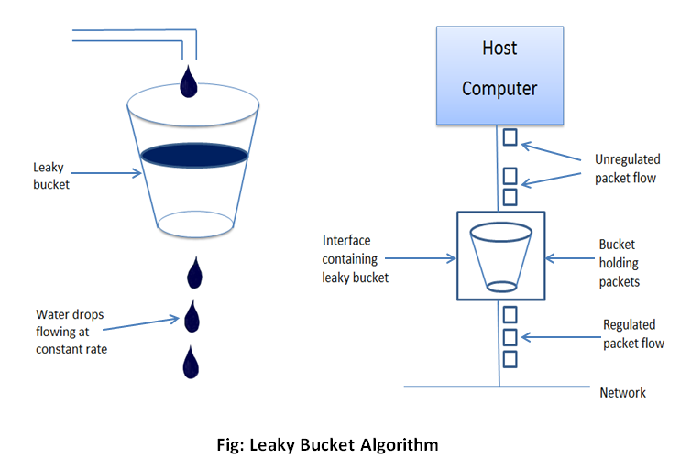

Slide 46
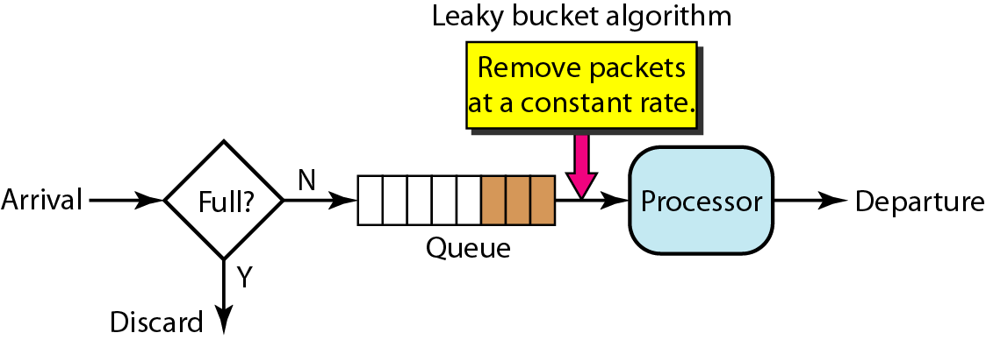
Figure 24.20 Leaky bucket implementation

Slide 47
Note
A leaky bucket algorithm shapes bursty traffic into fixed-rate traffic by averaging the data rate. It may drop the packets if the bucket is full.

Slide 48
Note
The token bucket allows bursty traffic at a regulated maximum rate.

Slide 49
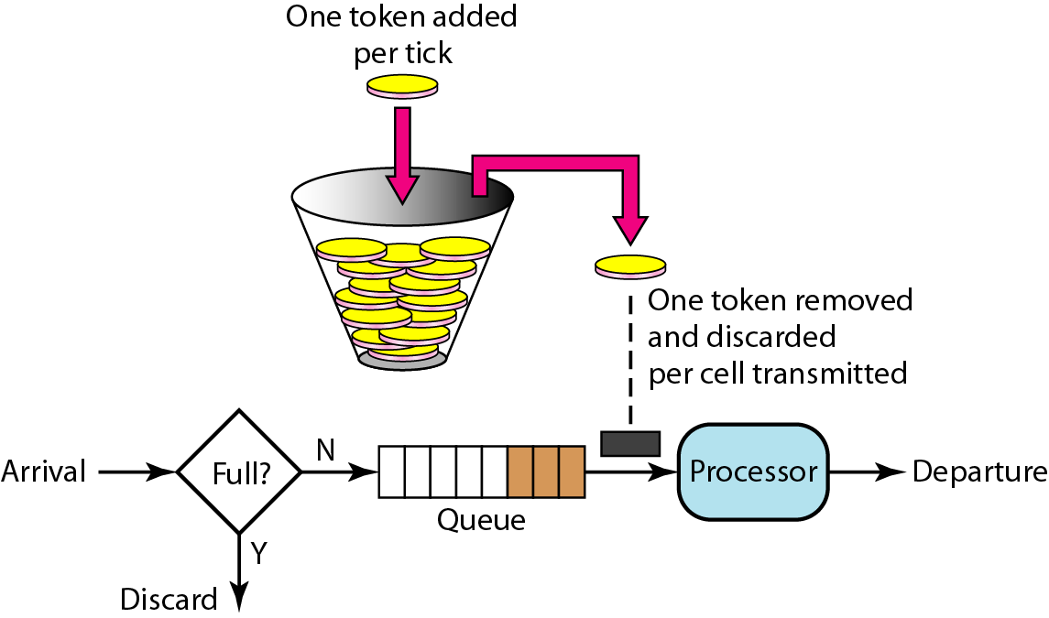
Figure 24.21 Token bucket

Slide 50
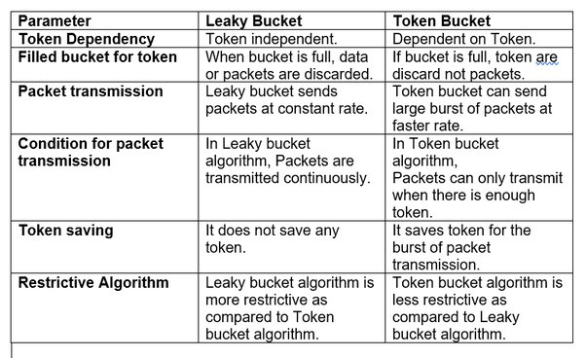

Slide 51
24-9 QoS IN SWITCHED NETWORKS
Let us now discuss QoS as used in two switched networks: Frame Relay and Asynchronous Transfer Mode. These two networks are virtual-circuit networks that need a signaling protocol such as Resource reservation protocol.
Topics discussed in this section:
QoS in Frame Relay QoS in ATM

Slide 52
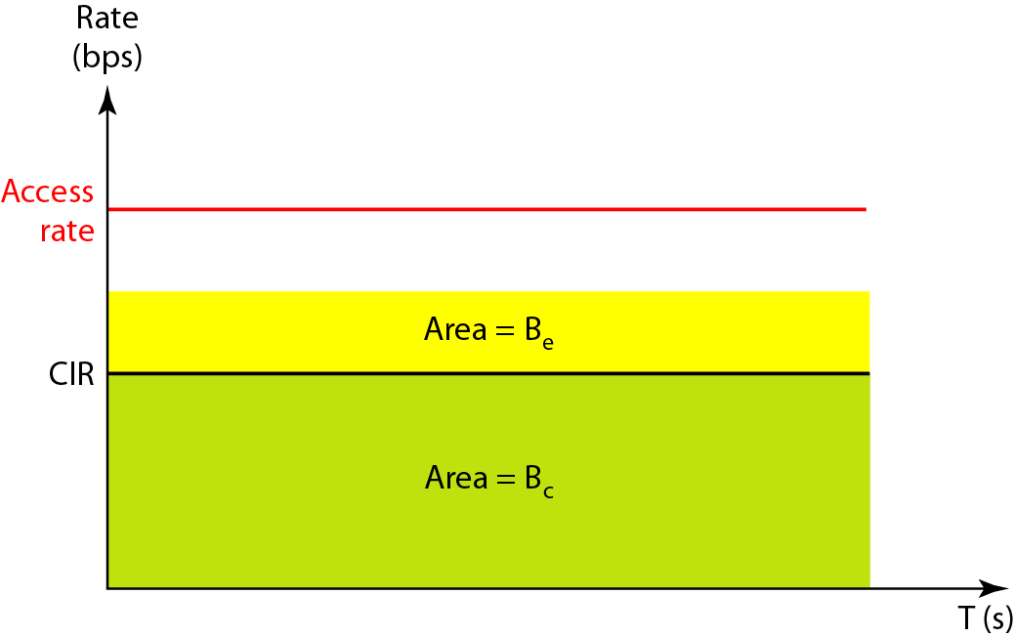
Qos in Frame relay
Figure 24.28 Relationship between traffic control attributes
Committed Information rate(CIR)
Excess burst size(Be)
Committed burst size(Bc)
CIR=BC/T bps

Slide 53
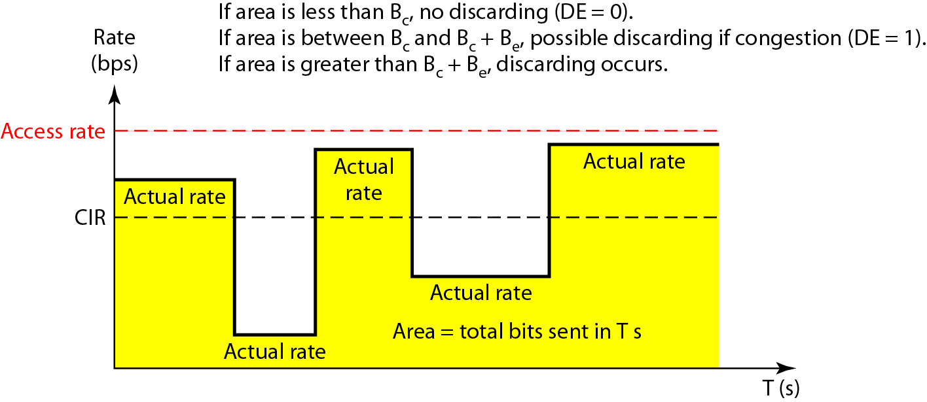
Figure 24.29 User rate in relation to Bc and Bc + Be

Slide 54
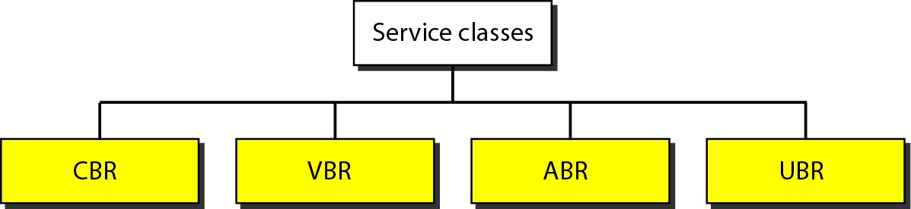
QOS in ATM
Figure 24.30 Service classes
CBR- Constant bit rate
VBR-Variable bit rate
ABR-Available bit rate
UBR- Unspecified bit rate

Slide 55
QoS feature is used when there is traffic congestion in-network, it gives priority to certain real-time media. A high level of QoS is used while transmitting real-time multimedia to eliminate latency and dropouts. Asynchronous Transfer Mode (ATM) is a networking technology that uses a certain level of QoS in data transmission.
The Quality of Service in ATM is based on following: Classes, User-related attributes, and Network-related attributes.

Slide 56
Classes : The ATM Forum defines four service classes that are explained below –
Constant Bit Rate (CBR) – CBR is mainly for users who want real-time audio or video services. The service provided by a dedicated line. For example, T line is similar to CBR class service.
Variable Bit Rate (VBR) – VBR class is divided into two sub classes –
(i) Real-time (VBR-RT) : The users who need real-time transmission services like audio and video and they also use compression techniques to create a variable bit rate, they use VBR-RT service class.
(ii) Non-real Time (VBR-NRT) : The users who do not need real-time transmission services but they use compression techniques to create a variable bit rate, then they use VBR-NRT service class.

Slide 57
Available Bit Rate (ABR) –ABR is used to deliver cells at a specific minimum rate and if more network capacity is available, then minimum rate can be exceeded. ABR is very much suitable for applications that have high traffic.
Unspecified Bit Rate (UBR) –UBR class and it is a best-effort delivery service that does not guarantee anything.

Slide 58
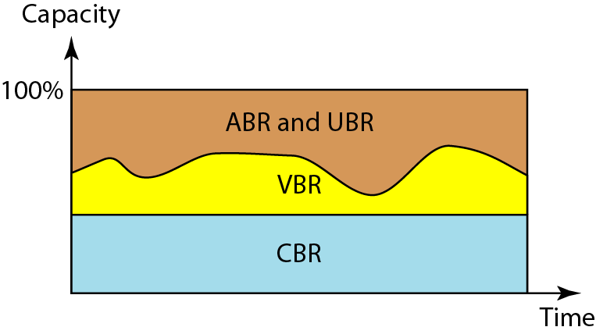
Figure 24.31 Relationship of service classes to the total capacity of the network

